Slide 1
M&T Bridge: Building Financial Futures
Notes:
Johnny

Slide 2
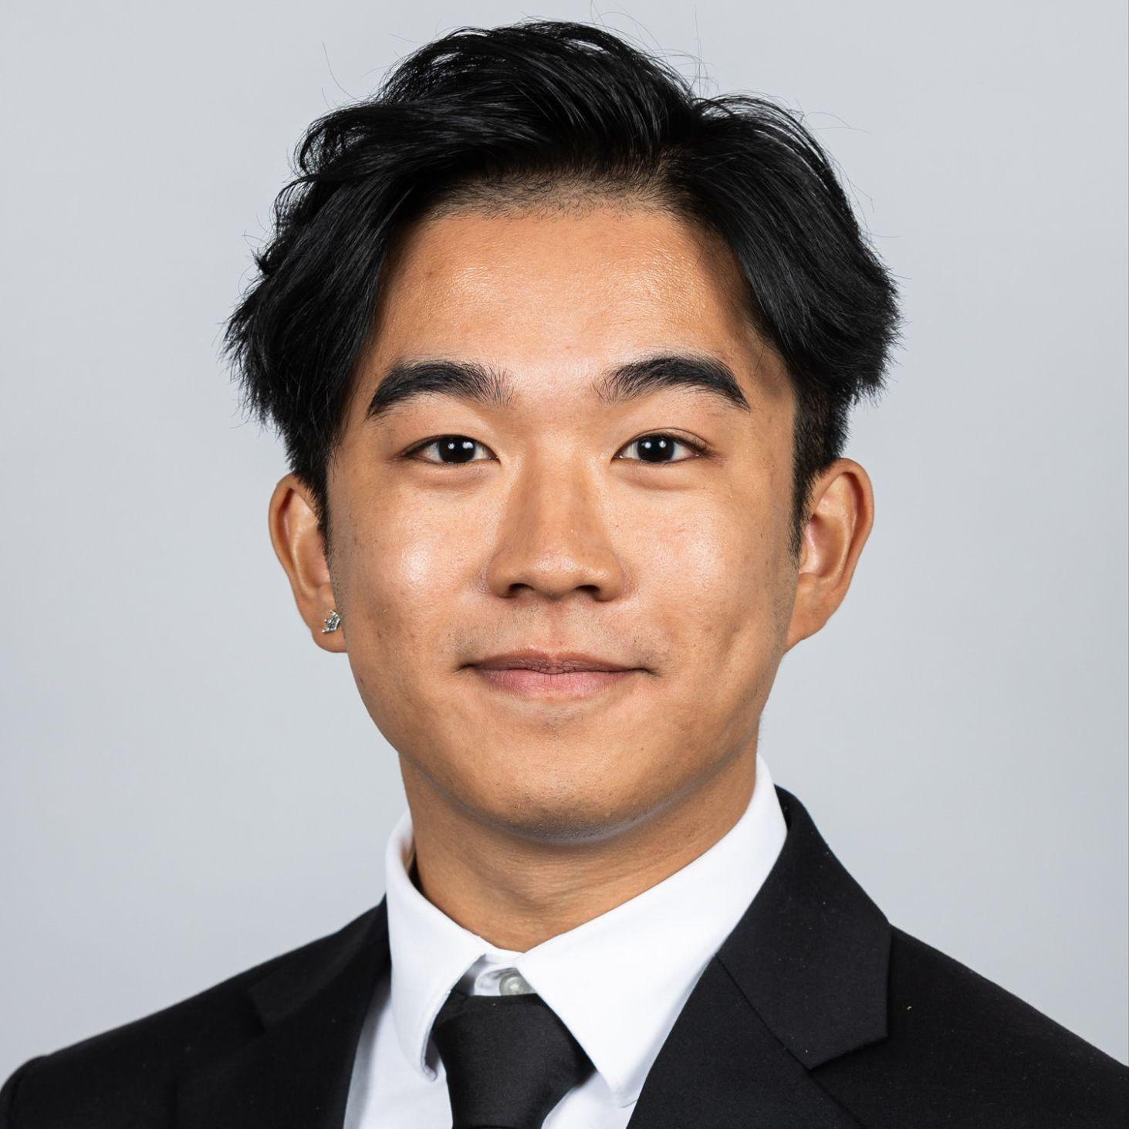

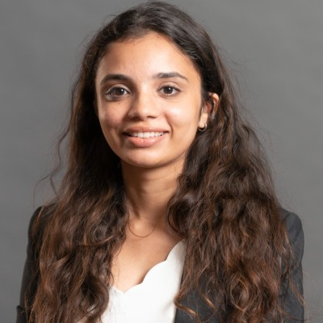
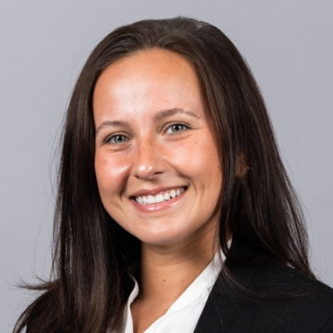
Our team
Johnny Hoang
Sydney Smith
Isha Joshi
Katelyn Israel
B.S Psychology
MiM
B.S Finance
MiM
BBA, MBA
MFin
B.A Psychology
MiM
Notes:
Johnny

Slide 3
Agenda
01
02
03
04
Identifying The Landscape
The M&T Bridge Program
Alignment with M&T
Conclusion
Notes:
Johnny → Pass onto Sydney for Slide 4

Slide 4
01
Identifying the Landscape
Going Beyond the Branch
Notes:
Sydney

Slide 5
The Uneven Playing Field: Employment, Housing, and Accessibility Hurdles in LMI Communities
(Huynh, 2020)
Employment Gap
Housing Instabilities
Job Accessibility
As of 2017, 35% of residents in LMI communities (18–64) were not working compared with 25% in non-LMI communities
LMI communities are 34% more likely to spend a high portion of their income on rent (over 35% of gross income)
0.73 workers per resident within LMI communities, while non-LMI communities have 1 worker per resident
Notes:
Sydney
Obtained from U.S Bureau of Labor Statistics → Monthly Labor Review

Slide 6

Financial Literacy Crisis: ⅓ Lack Basic Knowledge, Costing Billions
⅓ of Americans have a working understanding of interest rates, mortgage rates, and financial rates, according to the Financial Industry Regulatory Authority.
(Mcmillan & Bryant, 2022)
Only 4% of children from low-income families will break the cycle of poverty and break into the upper-middle class.
(Joanne, 2021)
This gap is estimated to have cost Americans more than $415 billion in 2020.
(Mcmillan & Bryant, 2022)
Notes:
Sydney

Slide 7
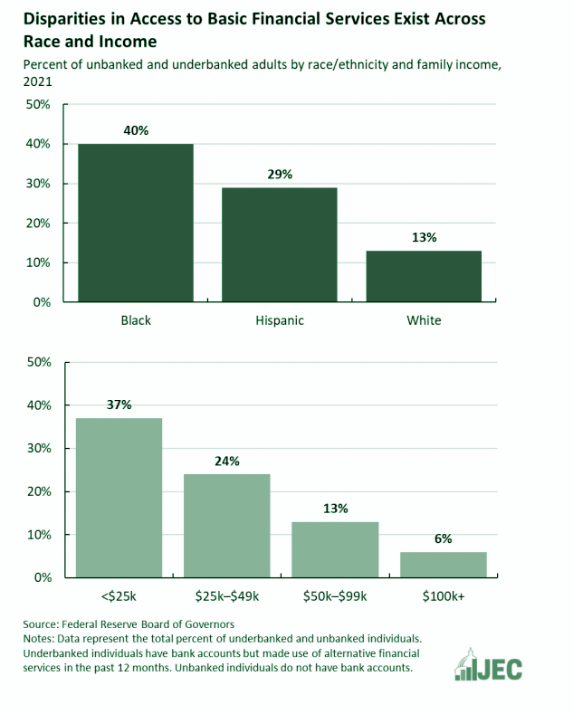
Black and Hispanic individuals have significantly lower rates of having bank accounts compared to white and higher-income households
(Joint Economic Committee, 2022)
Black and Hispanic individuals, as well as those with lower incomes, have significantly lower rates of having bank accounts compared to white and higher-income households
Clear disparity in access to basic financial services between different racial and income group
(Beyer, 2022)
Notes:
Visual representation of the gap in access to banking services across race and income groups underscores the necessity of a program specifically designed to address this issue in LMI communities
Program should focus on reaching Black and Hispanic communities, as well as low-income residents, who are disproportionately affected by this lack of access

Slide 8
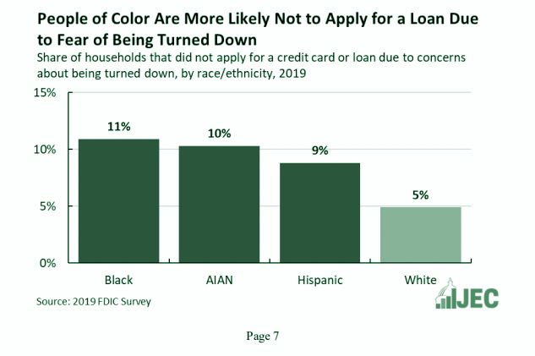
The Fear of Being Rejected from a Loan Poses a Barrier for People of Color
(Joint Economic Committee, 2022)
Often rely on predatory lenders who charge high fees and interest rates, trapping them in cycles of debt
Black households are 2.7x more likely than white households to use pawnshop loans
(Beyer, 2022)
Stereotype Threat Phenomenon → perpetuate the existing disparity in access to credit for LMI communities and minorities
Notes:
Pawnshop Loan: To borrow the money you must produce an item of value as collateral – such as a piece of jewelry, a musical instrument, electronics, or an antique – that provides backing for the loan. → Pawnshops will typically offer you 25% to 60% of the resale value of an item (SoFi) (Kilham, 2022)
Use of alternative financial products (payday loans) comes out of necessity
Payday loans → Triple-digit interest rates
These individuals lack access to tools like online bill pay and automatic transfers, making financial management more difficult
Stereotype Threat: A situation where a person is aware of a negative stereotype about their group and experiences anxiety that could confirm that stereotype.
People of color might be aware of historical or perceived biases in loan lending and fear rejection based on their race or ethnicity.
TRANSITION: Challenges faced by banks when lending to low-and-moderate income (LMI) communities → Lower credit scores and higher default rates among LMI borrowers
Johnny → Pass onto Isha

Slide 9
02
The M&T Bridge Program
Building Financial Futures
Notes:
Isha

Slide 10
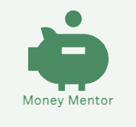

The M&T Bridge Program in Action
Financial Literacy & Inclusion:
Utilizes existing M&T Money Mentor resources.
Offer virtual and in-person classes (partner with libraries/community centers/business schools).
Include gamification elements like quizzes and games with rewards (e.g., discounts).
Financial Empowerment & Products:
Create a platform connecting LMI communities to investors, social enterprises, and philanthropists.
Develop specialized products like microloans for LMI residents.
Notes:
Isha

Slide 11
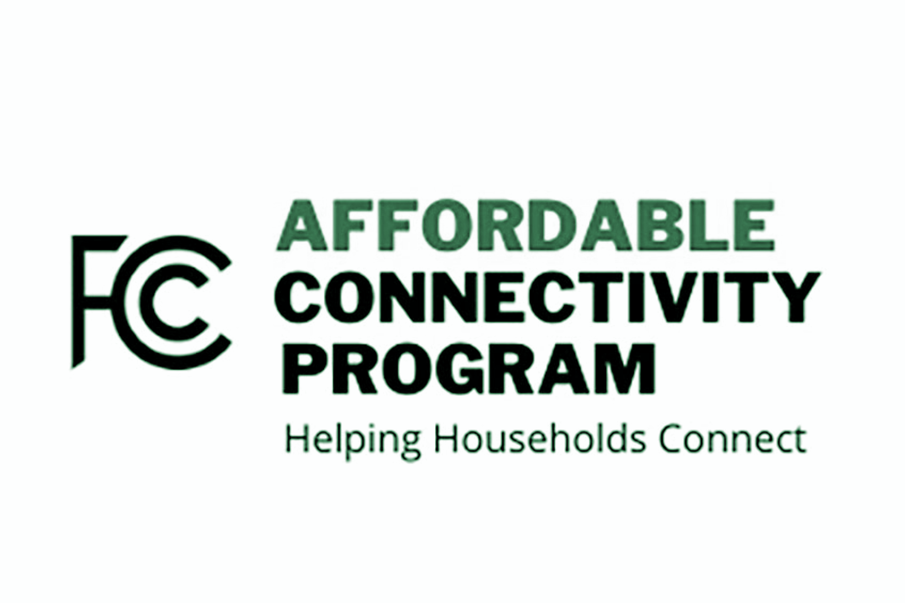
Closing the Digital Divide
Affordable Connectivity Program (ACP) helps households afford Broadband, or high-speed internet, for work, school, healthcare, etc. (FCC, 2024)
While ACP provides subsidies, barriers to access still remain prominent such:
Understanding eligibility requirements
Limited digital literacy to sign up
Lack of device to sign-up
WHERE M&T BRIDGE COMES IN:
Promotes ACP program within communities and assist participants with enrollment
Partner with companies participating in ACP such as Unity Wireless, Inc.
Workshops on digital literacy
Notes:
Isha
On April 2, 2024 Federal Communications Commission Updates Congress on Impact of Imminent End of ACP → States that ACP is on the brink of shutting down due to lack of funding, program is the largest broadband affordability effort in Nation’s history (More than 23 million households nationwide rely on ACP)
Demonstrates M&T’s commitment to working toward alleviating the digital divide → Positions M&T as a collaborative partner w/ the government in achieving shared goals

Slide 12
Creating Tailored Products for LMI Communities
Secure Balance
SaveRewards
SmartSpend Card
FlexFund Solution
EarnEdge Benefits
TaxSmart Account
Notes:
Isha
Account linking: "SecureBalance" - SecureBalance is a feature that automatically links your checking account to another account, such as a savings account or a credit card. In case your checking account balance falls below a certain threshold, SecureBalance transfers funds from the linked account to cover overdrafts. This helps LMI individuals avoid costly overdraft fees and maintain financial stability, ensuring that essential transactions are not declined due to insufficient funds.
Overdraft line of credit: "SafetyNet Reserve" - SafetyNet Reserve provides a line of credit tied to your checking account to cover overdrafts. In situations where your account balance is insufficient to cover a transaction, SafetyNet Reserve automatically advances funds, preventing declined transactions and potential fees. This product offers peace of mind to LMI individuals, protecting them from financial setbacks and empowering them to manage their finances more effectively.
Low-fee debit or stored-value card: "SmartSpend Card" - The SmartSpend Card is a debit or stored-value card with minimal fees designed for LMI individuals. It helps them control their spending by declining transactions that exceed the available balance, thus preventing overdrafts and unnecessary fees. The SmartSpend Card promotes responsible financial management and ensures that individuals stay within their budget, avoiding debt accumulation and financial strain.
Direct Deposit: "QuickPay Access" - QuickPay Access enables LMI individuals to receive their income directly into their checking accounts through direct deposit. By eliminating the need for paper checks or cashing services, QuickPay Access ensures timely access to funds and facilitates financial transactions. This product offers convenience and accessibility, enabling individuals to manage their finances more efficiently and securely.
Workplace banking programs: "EarnEdge Benefits" - EarnEdge Benefits is a workplace banking program that incentivizes employees to use direct deposit by offering special pricing or waivers on banking services. By making banking more affordable and accessible, EarnEdge Benefits encourages financial inclusion among the workforce, empowering LMI individuals to establish mainstream banking relationships and access essential financial services.
Tax-preparation services: "TaxSmart Account Setup" - TaxSmart Account Setup facilitates access to financial services by helping LMI individuals open new accounts for direct deposit of tax refunds. By ensuring timely access to funds and promoting mainstream banking relationships, TaxSmart Account Setup empowers individuals to manage their finances more effectively and achieve greater financial stability. This product simplifies the process of setting up accounts and encourages individuals to utilize direct deposit for their tax refunds, thereby enhancing financial inclusion and accessibility.
Rewards programs linked to savings: "SaveRewards Initiative" - SaveRewards Initiative encourages saving through rewards programs that link savings accounts to everyday spending. By rounding up debit card purchases and transferring the difference to a savings account, SaveRewards Initiative incentivizes individuals to build emergency funds and long-term savings. This initiative promotes financial security and asset accumulation among LMI individuals, fostering a culture of saving and wealth building.
Affordable small-dollar lending programs: "FlexFund Solutions" - FlexFund Solutions offers reasonably priced small loans with streamlined underwriting for emergency needs. By providing access to affordable credit at rates below 36 percent APR, FlexFund Solutions helps LMI individuals address immediate financial challenges without resorting to high-cost payday loans or predatory lending practices. This program promotes financial well-being and stability by offering safe and accessible credit options to underserved communities.

Slide 13
The Essential Components to Building the Successful Program
Technology Infrastructure
Marketing & Outreach
Digital Inclusion & Partnerships
User friendly interface, software
Marketing Campaign, Social media, Collab
Partnership with Internet Service Providers (ISPs)
Staff Training
Financial Products & Services
Measurement
Facilitators for virtual classes, curriculum
Specialized products tailored for LMI communities
Data Tracking and analysis
Notes:
Isha
Needs to be cost effective for the administrators and time effective for the participants

Slide 14
The Significant Untapped Market is a Potential Profit for M&T
Baltimore Metropolitan Population
2,840,000
Total Population Unbanked (5.9%) and Underbanked (12.2%)
514,000
Multiplied by 14%
“The World Economic Forum reports that in economies with higher financial literacy, the average use of banking services increases by 14%.” (Musa, 2024)
~72,000
Multiplied by $1,819
From a survey from the National Financial Educators Council, the average cost per individual of poor financial literacy was $1,819. (O'Brien, 2023)
Total increase in money towards banking services:
~$131,000,000
Notes:
Sydney

Slide 15
Preventing CyberSecurity and Partnership Risks
Information Security Awareness Program
Employment of Multiple Layers of Security and Defense
Establish Memorandum of Understanding (MOU)
Offer training sessions
Notes:
Sydney to Johnny

Slide 16
03
Alignment with
M&T
Strengthening M&T and LMI Communities Together
Notes:
Johnny

Slide 17
M&T Bank Outlines $43 Billion Community Growth Plan (M&T Bank, 2021)
Target Audience
Complimentary
Feeder Program
Both focuses on LMI communities and communities of color
Program provides the groundwork for successful loan applications within the Community Growth Plan
Prepares LMI borrowers for successful loan applications under the Community Growth Plan
Notes:
Johnny
Aligns with their commitment to address inequities and increase lending in these areas
Program can ensure qualified borrowers are prepared to access the $23 billion allocated for loans
Use the program to gather data on the needs and challenges faced by LMI communities → Then use the data to inform the development of targeted loan products and financial services under the Community Growth Plan
Johnny → Sydney

Slide 18

CRA Compliance
CRA is designed to encourage banks to help rebuild and revitalize communities through sound lending and good business judgment that benefits the banks and the communities they serve.
Under the CRA, M&T is compliant through:
Providing financial opportunities for low-moderate income communities (below 80% of the area median income)
Offering flexible products to enhance the level of lending in LMI geographies
Ensuring LMI communities are financially literate and have access to online financial resources
Notes:
Sydney
A low-income community means there is a median family income of less than 50 percent of the area median income.
A moderate-income community means that the median family income is at least 50 percent AND less than 80 percent of the area median income.

Slide 19

Stakeholder Engagement
A.
Community Workshops & Forums
B.
Advisory Boards
C.
Surveys and Feedback Mechanism
D.
Community Events
E.
Regular Communication & Updates
Notes:
Sydney

Slide 20
04
Conclusion
Planting the Seeds of Prosperity
Notes:
Sydney to Johnny

Slide 21
Goal
M&T Bridge will increase financial literacy, bridge the digital divide, and give LMI residents endless opportunities
Notes:
Johnny

Slide 22
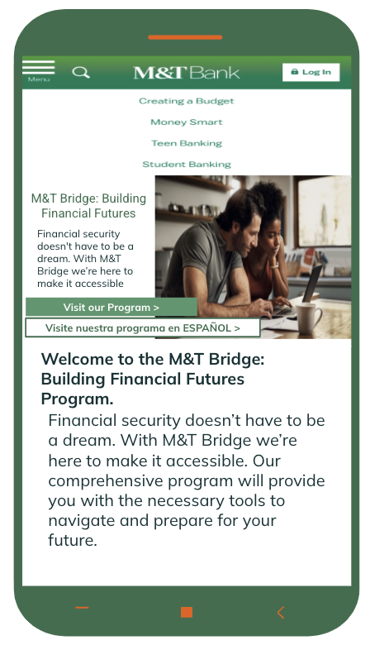
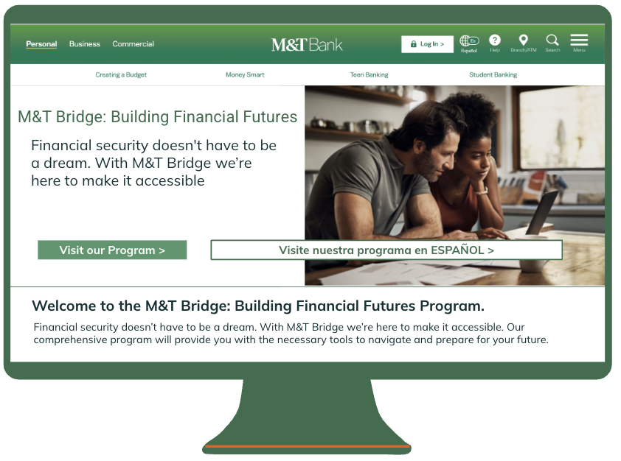
Notes:
Johnny

Slide 23
A Symbiotic Program Ensuring Benefits for Both Parties
Benefits for M&T Bank
Benefits for LMI Communities
Enhanced Reputation
Customer Acquisition and Retention
Market Expansion
Innovation & Differentiation
Financial Inclusion
Improves Financial Literacy
Entrepreneurship Support
Digital Inclusion
Notes:
Isha
Double-bottom line: helping LMI communities and will see a ROI
Enhanced reputation: According to Cone Communications, 87% of consumers are more likely to trust and be loyal to companies that support social or environmental issues.
Customer acquisition and retention: By offering tailored financial products and services to underserved communities, M&T Bank can attract new customers and retain existing ones. research done by Frederick Reichheld of Bain & Company (the inventor of the net promoter score) that shows increasing customer retention rates by 5% increases profits by 25% to 95%.
Market Expansion: Serving LMI communities presents opportunities for market expansion and growth. According to the FDIC, there are over 25 million underbanked households in the United States, representing a significant untapped market for financial institutions.
Financial Inclusion: Access to affordable financial products and services empowers LMI individuals to participate in the formal banking system, build credit, and achieve financial stability. The World Bank estimates that financial inclusion can boost GDP growth by 1.7% annually.
Improved Financial Literacy: Educational initiatives offered through the program can improve financial literacy and money management skills among LMI individuals, leading to better financial decision-making and long-term economic empowerment.
Entrepreneurship Support: Providing access to specialized financial products like microloans and connecting LMI entrepreneurs with investors can stimulate entrepreneurship and economic development within LMI communities. The Kauffman Foundation reports that small businesses account for 65% of net new job creation.
Digital Inclusion: Partnerships to provide subsidized internet access and digital literacy training bridge the digital divide, enabling LMI individuals to access online banking services, educational resources, and employment opportunities. A study by the Federal Reserve found that 84% of job postings require basic digital skills.

Slide 24
—Warren Buffett
“Someone’s sitting in the shade today because someone planted a tree a long time ago.”
Notes:
Sydney
Investing in LMI communities is a risky investment, and M&T should not embark on this with the intent of earning a profit. Morally speaking, earning a profit on LMI communities has typically been seen through fee charges, deposit balances not maintaining the correct balance, and finance charges on loans. Our goal is develop these communities and establish financial literacy. Therefore we’re aware of this risk, however M&T will see these communities as active members of the bank and generating revenue in the future, and their children will be financially literate.

Slide 25

Thank You!
Please keep this slide for attribution
Notes:
Sydney

Slide 26
References
American Psychological Association. (2015, February 4). APA survey shows money stress weighing on Americans’ health nationwide [Press release].
https://www.apa.org/news/press/releases/2015/02/money-stress
Beyer, D. (2022). People of Color and Low-Income Communities Are Disproportionately Harmed by Banking and Financial Exclusion. Joint
Economic Committee Democrats. https://www.jec.senate.gov/public/index.cfm/democrats/2022/8/people-of-color-and-low-income-communities-are-disproportionately-harmed-by-banking-and-financial-exclusion
Dr. Joanne, L. (2021, May 10). Op-ed: Make financial literacy in underserved communities a national priority. CNBC.
https://www.cnbc.com/2021/05/02/op-ed-why-financial-literacy-needs-to-be-a-national-priority.html
FDIC National Survey of Unbanked and Underbanked Households. (2021). https://www.fdic.gov/analysis/household-survey/2021appendix.pdf
Huynh, N. L., (2020). Employment Barriers Within Low - and Moderate - Income Communities. U.S Bureau of Labor Statistics.
https://www.bls.gov/opub/mlr/2020/beyond-bls/employment-barriers-within-low-and-moderate-income-communities.htm#:~:text=LMI%20tracts%20are%2034%20percent,for%20non%2DLMI%20communities
Kilham, A. (2022). Pawnshop Loan: What is it & How Does it Work? SoFI Learn. https://www.sofi.com/learn/content/pawnshop-loan/
Mcmillan, D., & Bryant, J. H. (2022, June 10). Financial Literacy Education could help many Americans. Time. https://time.com/6186290/americans-financial-literacy/
Musa, A. (2024, February 11). Are we underestimating the impact of Financial Literacy and GDP?. LinkedIn.
https://www.linkedin.com/pulse/we-underestimating-impact-financial-literacy-gdp-ambareen-musa-tb6vf/
M&T Bank. (2021). M&T Bank Outlines $43 Billion Community Growth Plan To Support Underserved, Communities of Color and Small
Businesses. M&T Bank. https://ir.mtb.com/news-releases/news-release-details/mt-bank-outlines-43-billion-community-growth-plan-support
O’Brien, S. (2023, January 19). Lack of financial literacy cost 15% of adults at least $10,000 in 2022. here’s how the rest fareed. CNBC.
https://www.cnbc.com/2023/01/19/heres-how-much-people-say-lack-of-financial-literacy-cost-in-2022.html

Slide 27
APPENDIX

Slide 28
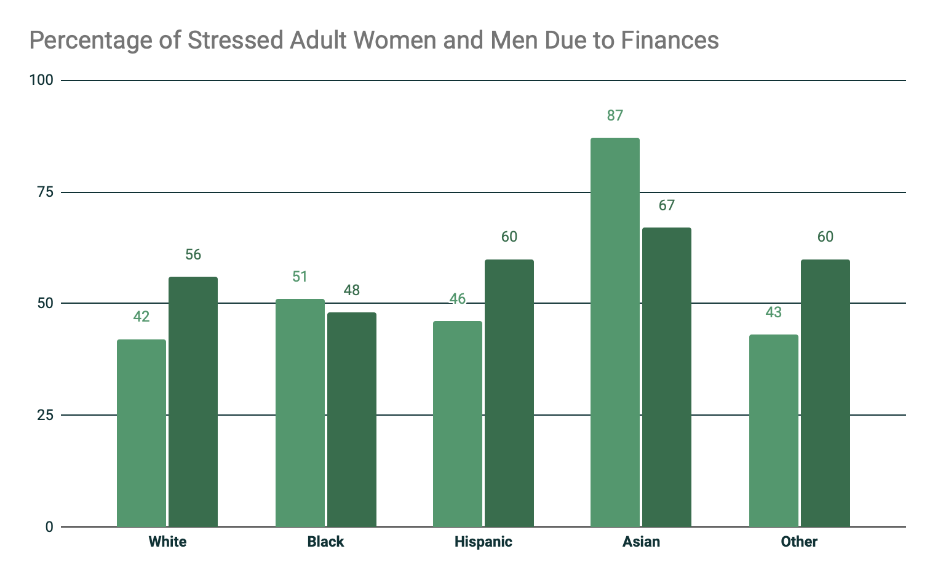
Issues of Equity, and the Social Problems that Reinforce them, are Tied to Financial Literacy
A higher degree of financial worries is associated with higher psychological distress
Social Stress Theory
Socio-Economic
Women almost consistently have higher levels of stress than men when it comes to discussing finances and financial literacy (GFLEC, 2021)
Notes:
Across all Linear regressions, a higher degree of financial worries was significantly associated with higher psychological distress
Strongest among individuals who were unmarried, unemployed, had the lowest income, and did not own a home
For the majority of americans (64%), money is a significant source of stress
Especially for parents (77%) and younger adults (75% of millennials and 76% of Gen Xers)
Social Stress Theory: disadvantaged populations could experience mental health problems due to greater vulnerability to stress
Nearly 1 in 5 Americans say that they have either considered skipping (9%) or skipped (12%) going to the doctor when they needed health care because of financial concerns
Socio-Economic Characteristics: they can worsen the negative relationship between financial worries and psychological distress
Since 2014 there has been a significant gap in stress levels between people living in lower-income (making less than $50,000 per year) and higher-income households.

Slide 29
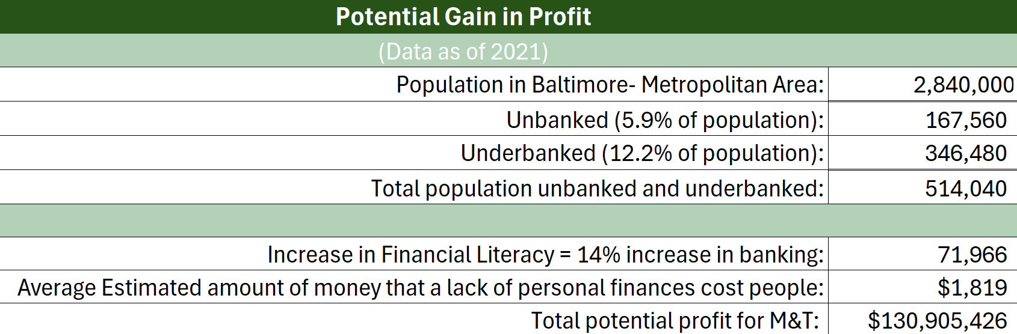
Investing in the future
“The World Economic Forum reports that in economies with higher financial literacy, the average use of banking services increases by 14%.” (Musa, 2024)

Slide 30
CRA Compliance
CRA is designed to encourage banks to help rebuild and revitalize communities through sound lending and good business judgment that benefits the banks and the communities they serve.
Under the CRA:
A low-income community means there is a median family income of less than 50 percent of the area median income.
A moderate-income community means that the median family income is at least 50 percent AND less than 80 percent of the area median income.

Slide 31
Scalability
1.
Train-The-Trainer Model
Train M&T staff and community partner to deliver financial literacy workshops
2.
M&T Branches as Hubs
Utilize for program activities
Pilot the Program
3.
Begin in a few LMI Communities, gather data & feedback, refine program for broader rollout access
Notes:
Reduces reliance on a centralized team
Activities such as In-person workshops, access to loan officers, and digital inclusion support
The generated revenue can subsidize program costs for LMI participants

Slide 32
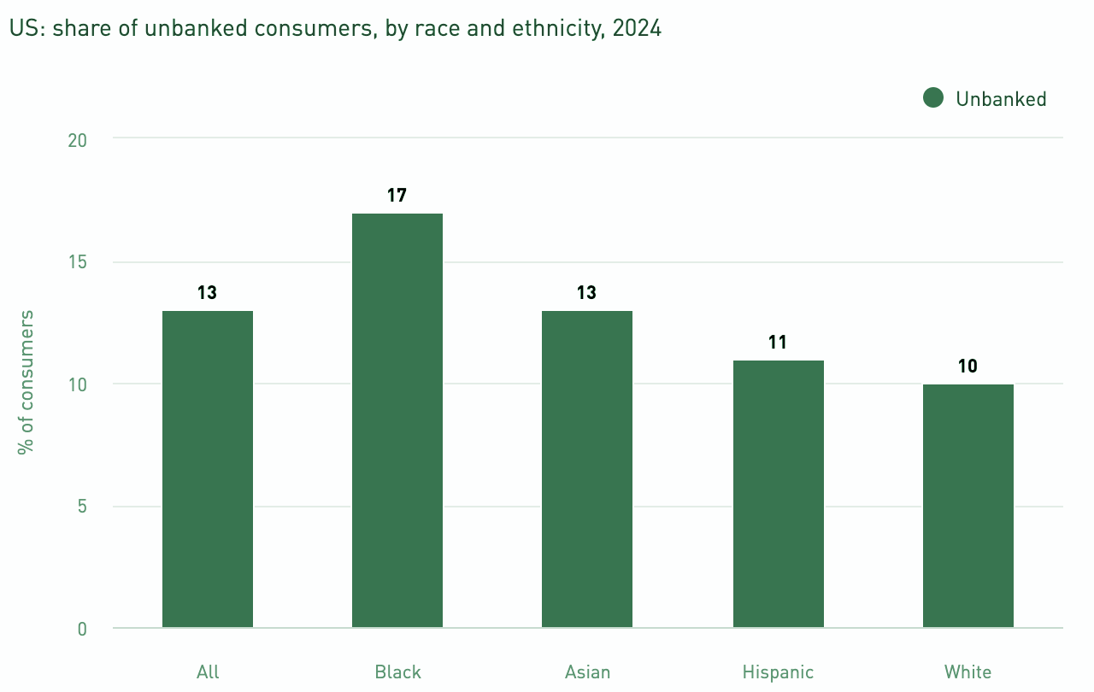
Black Consumers are the Most Likely to be the Group of Unbanked Consumers in the U.S
Estimated national percentage of unbanked consumers by race in the entire U.S Population
Notes:
(Appendix) → Mintel

Slide 33
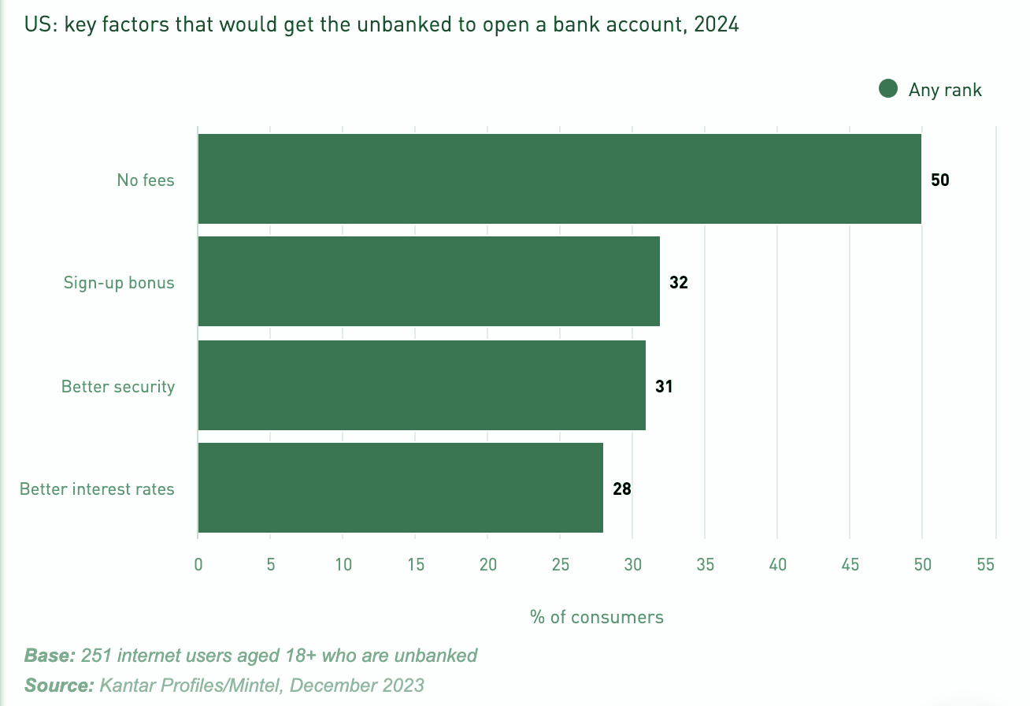
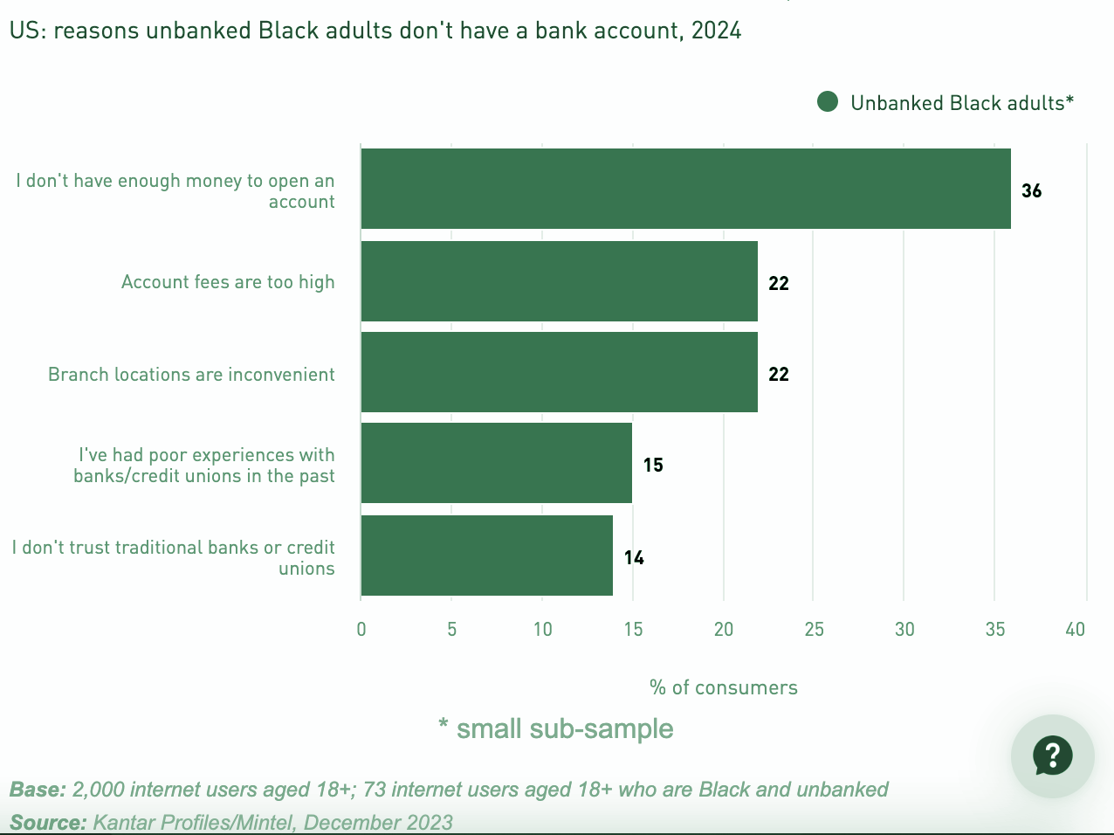
Fintechs and online-only banks with fee-free model remain well-positioned to capture an unbanked segment that puts affordability above all
Notes:
(Appendix) → Mintel

Slide 34
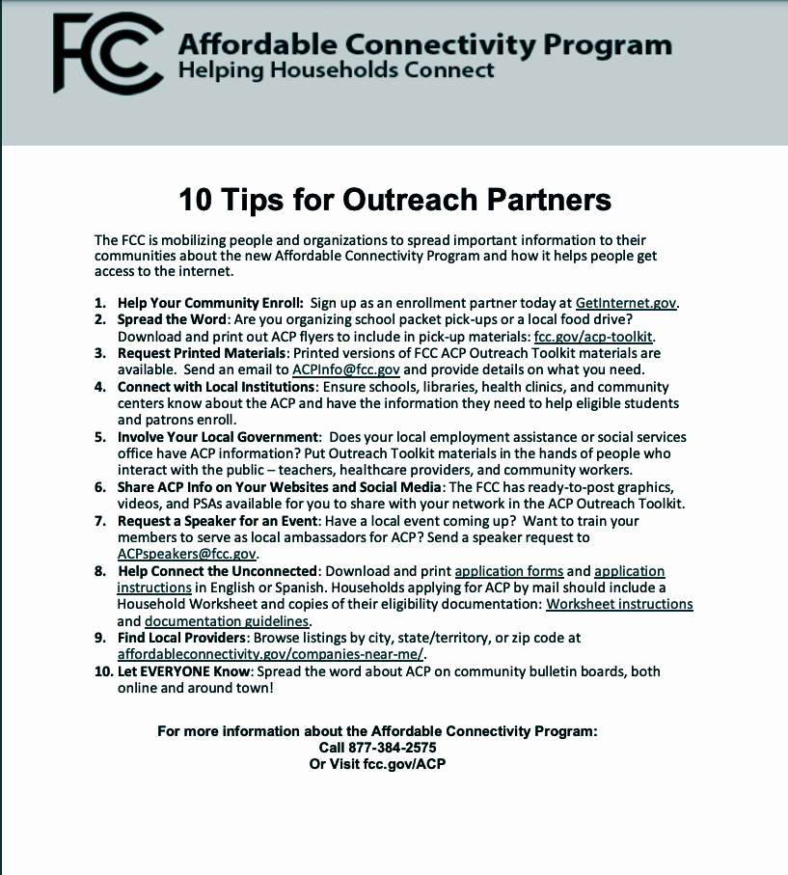
Affordable Connectivity Program - 10 Tips for Outreach Partners
Notes:
(Appendix) → Mintel

Slide 35
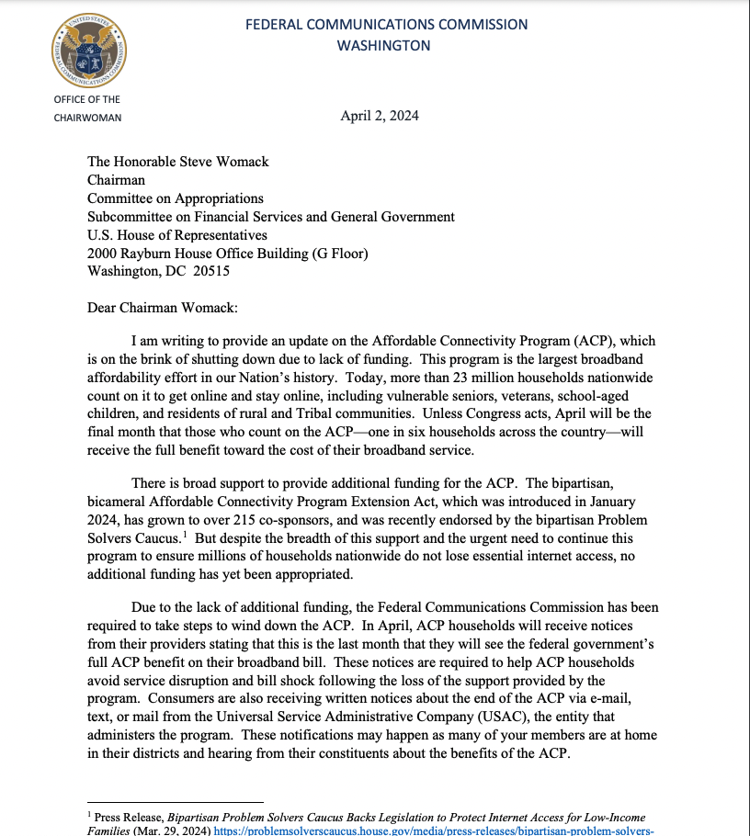
FCC Letter to Congress
Notes:
(Appendix) → Mintel

Slide 36
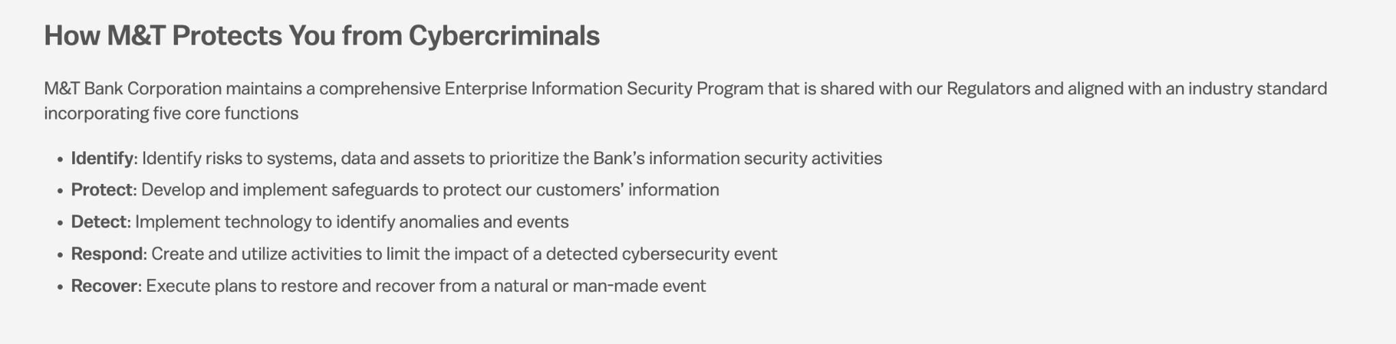
M&T Protection from Cybercriminals
Notes:
(Appendix) → Mintel

Slide 37
Approaches to Sustain the M&T Bridge Program
1.
Cost Sharing Partnerships
Libraries, Schools, Development Centers
2.
Volunteer Network
M&T employees, Community Leaders, and/or retirees
Social Enterprise Model
3.
Fee-for-service component for specific financial products or advanced workshops
Smith School of Business
4.
Students teach basic financial concepts/modules to LMI communities as a part of the coursework
Notes:
Sydney
Can provide space for workshops, staff time for co-facilitation, or marketing channels
This can supplement staff and expand program reach
The generated revenue can subsidize program costs for LMI participants

